Slide 2
Dictionaries
Dictionary: object that stores a collection of data
  Each element consists of a key and a value
    Often referred to as mapping of key to value
    Key must be an immutable object
  To retrieve a specific value, use the key associated with it
phonebook = {'Chris':'555−1111', 'Katie':'555−2222', 'Joanne':'555−3333'}

Slide 3
Retrieving a Value from a Dictionary
Elements in dictionary are unsorted
General format for retrieving value from dictionary: dictionary[key]
  If key in the dictionary, associated value is returned, otherwise, KeyError exception is raised
Test whether a key is in a dictionary using the in and not in operators
  Helps prevent KeyError exceptions

Slide 4
Example
Example –
phonebook['Chris’]
Result – ‘555-1111’
phonebook['Kathryn’]
Traceback (most recent call last):
File "<pyshell#5>", line 1, in <module>
phonebook['Kathryn']
KeyError: 'Kathryn'

Slide 5
Example
To avoid KeyError check if key exists in dictionary:
if 'Chris' in phonebook:
  print(phonebook['Chris’])
if 'Joanne' not in phonebook:
print('Joanne is not found.')

Slide 6
Adding Elements to an Existing Dictionary
Dictionaries are mutable objects
To add a new key-value pair:
dictionary[key] = value
  If key exists in the dictionary, the value associated with it will be changed
    phonebook['Joe'] = '555−0123’
    phonebook['Chris'] = '555−4444’
    phonebook

Slide 7
Deleting Elements From an Existing Dictionary
To delete a key-value pair:
del dictionary[key]
  If key is not in the dictionary, KeyError exception is raised
  del phonebook['Chris’]
  (if you try it twice you will get an error)

Slide 8
Getting the Number of Elements and Mixing Data Types
len function: used to obtain number of elements in a dictionary
  phonebook = {'Chris':'555−1111', 'Katie':'555−2222’}
  num_items = len(phonebook)
  print(num_items)
  Output - 2
Values stored in a single dictionary can be of different types

Slide 9
Creating an Empty Dictionary and Using for Loop to Iterate Over a Dictionary
To create an empty dictionary:
  Use {}
  Use built-in function dict()
  Elements can be added to the dictionary as program executes
Use a for loop to iterate over a dictionary
  General format: for key in dictionary:
    for key in phonebook:
    Print(key)

Slide 10
Some Dictionary Methods (cont’d.)
items method: returns all the dictionaries keys and associated values
  Format: dictionary.items()
  Returned as a dictionary view
    Each element in dictionary view is a tuple which contains a key and its associated value
    Use a for loop to iterate over the tuples in the sequence
      Can use a variable which receives a tuple, or can use two variables which receive key and value

Slide 11
Example
phonebook = {'Chris':'555−1111',
'Katie':'555−2222',
'Joanne':'555−3333'}
for key, value in phonebook.items():
print('KEY:',key,'VALUE:', value)
for phonebook_tuple in phonebook.items():
print(phonebook_tuple)
Output:
KEY: Chris VALUE: 555−1111
KEY: Katie VALUE: 555−2222
KEY: Joanne VALUE: 555−3333
('Chris', '555−1111')
('Katie', '555−2222')
('Joanne', '555−3333')

Slide 12
Some Dictionary Methods
clear method: deletes all the elements in a dictionary, leaving it empty
  Format: dictionary.clear()
get method: gets a value associated with specified key from the dictionary
  Format: dictionary.get(key, default)
    default is returned if key is not found
  Alternative to [] operator
    Cannot raise KeyError exception

Slide 13
Example
phonebook = {'Chris':'555−1111', 'Katie':'555−2222’}
value = phonebook.get('Katie','Entry not found’)
print(value)
value = phonebook.get('Andy', 'Entry not found’)
print(value)
Output:
555-2222
Entry not found

Slide 14
Some Dictionary Methods (cont’d.)
keys method: returns all the dictionaries keys as a sequence
  Format: dictionary.keys()
pop method: returns value associated with specified key and removes that key-value pair from the dictionary
  Format: dictionary.pop(key, default)
    default is returned if key is not found

Slide 15
Some Dictionary Methods (cont’d.)
popitem method (currently not working right): returns a randomly selected key-value pair and removes that key-value pair from the dictionary
  Format: dictionary.popitem()
  Key-value pair returned as a tuple
values method: returns all the dictionaries values as a sequence
  Format: dictionary.values()
  Use a for loop to iterate over the values

Slide 16
Example
person = {}
Person[‘fname’] = 'Joe'
person['lname'] = 'Fonebone'
person['age'] = 51
person['spouse'] = 'Edna'
person['children'] = ['Ralph', 'Betty', 'Joey’]
person['pets'] = {'dog': 'Fido', 'cat': 'Sox'}

Slide 17
Example
person['children’]
OUTPUT - ['Ralph', 'Betty', 'Joey’]
person['children’][1]
OUTPUT – ‘Betty’
person['pets’][‘cats’]
OUTPUT - 'Sox'

Slide 18
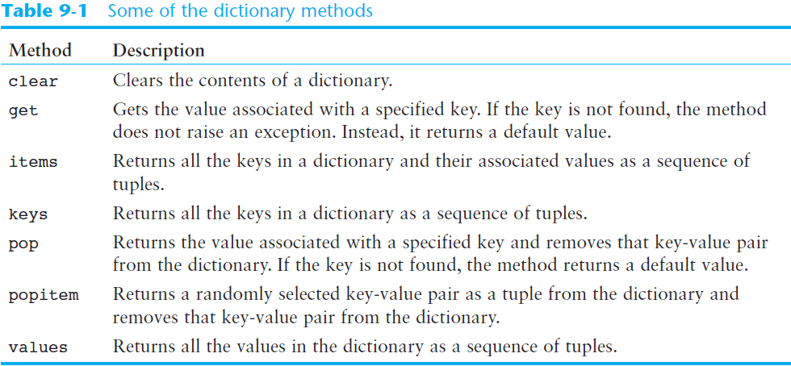
Some Dictionary Methods (cont’d.)

Slide 19
Exercise
Use a Dictionary to simulate a Deck of Cards
  The program should prompt the user for the number of cards to deal, and it randomly deals a hand of that many cards from the deck. The names of the cards should be displayed, as well as the total numeric value of the hand. Create three functions – main(), create_deck() and deal_cards().
  deck = {'Ace of Spades':1, '2 of Spades':2, '3 of Spades':3,'4 of Spades':4, '5 of Spades':5, '6 of Spades':6,
  '7 of Spades':7, '8 of Spades':8, '9 of Spades':9,'10 of Spades':10, 'Jack of Spades':10,'Queen of Spades':10, 'King of Spades': 10,
  'Ace of Hearts':1, '2 of Hearts':2, '3 of Hearts':3,'4 of Hearts':4, '5 of Hearts':5, '6 of Hearts':6,'7 of Hearts':7, '8 of Hearts':8, '9 of Hearts':9,'10 of Hearts':10, 'Jack of Hearts':10,'Queen of Hearts':10, 'King of Hearts': 10,'Ace of Clubs':1, '2 of Clubs':2, '3 of Clubs':3,
  '4 of Clubs':4, '5 of Clubs':5, '6 of Clubs':6,'7 of Clubs':7, '8 of Clubs':8, '9 of Clubs':9,'10 of Clubs':10, 'Jack of Clubs':10,'Queen of Clubs':10, 'King of Clubs': 10,'Ace of Diamonds':1, '2 of Diamonds':2, '3 of Diamonds':3,'4 of Diamonds':4, '5 of Diamonds':5, '6 of Diamonds':6,'7 of Diamonds':7, '8 of Diamonds':8, '9 of Diamonds':9,'10 of Diamonds':10, 'Jack of Diamonds':10,'Queen of Diamonds':10, 'King of Diamonds': 10}
  OUTPUT :
  How many cards should I deal? 5
  8 of Hearts
  5 of Diamonds
  5 of Hearts
  Queen of Clubs
  10 of Spades
  Value of this hand: 38

Slide 20
Sets
Set: object that stores a collection of data in same way as mathematical set
  All items must be unique
  Set is unordered
  Elements can be of different data types

Slide 21
Creating a Set
set function: used to create a set
  For empty set, call set()
  For non-empty set, call set(argument) where argument is an object that contains iterable elements
    e.g., argument can be a list, string, or tuple
    If argument is a string, each character becomes a set element
      For set of strings, pass them to the function as a list
    If argument contains duplicates, only one of the duplicates will appear in the set

Slide 22
Getting the Number of and Adding Elements
len function: returns the number of elements in the set
Sets are mutable objects
add method: adds an element to a set
update method: adds a group of elements to a set
  Argument must be a sequence containing iterable elements, and each of the elements is added to the set

Slide 23
Deleting Elements From a Set
remove and discard methods: remove the specified item from the set
  The item that should be removed is passed to both methods as an argument
  Behave differently when the specified item is not found in the set
    remove method raises a KeyError exception
    discard method does not raise an exception
clear method: clears all the elements of the set

Slide 24
Using the for Loop, in, and not in Operators With a Set
A for loop can be used to iterate over elements in a set
  General format: for item in set:
  The loop iterates once for each element in the set
The in operator can be used to test whether a value exists in a set
  Similarly, the not in operator can be used to test whether a value does not exist in a set

Slide 25
Finding the Union of Sets
Union of two sets: a set that contains all the elements of both sets
To find the union of two sets:
  Use the union method
    Format: set1.union(set2)
  Use the | operator
    Format: set1 | set2
  Both techniques return a new set which contains the union of both sets

Slide 26
Finding the Intersection of Sets
Intersection of two sets: a set that contains only the elements found in both sets
To find the intersection of two sets:
  Use the intersection method
    Format: set1.intersection(set2)
  Use the & operator
    Format: set1 & set2
  Both techniques return a new set which contains the intersection of both sets

Slide 27
Finding the Difference of Sets
Difference of two sets: a set that contains the elements that appear in the first set but do not appear in the second set
To find the difference of two sets:
  Use the difference method
    Format: set1.difference(set2)
  Use the - operator
    Format: set1 - set2

Slide 28
Finding the Symmetric Difference of Sets
Symmetric difference of two sets: a set that contains the elements that are not shared by the two sets
To find the symmetric difference of two sets:
  Use the symmetric_difference method
    Format: set1.symmetric_difference(set2)
  Use the ^ operator
    Format: set1 ^ set2

Slide 29
Finding Subsets and Supersets
Set A is subset of set B if all the elements in set A are included in set B
To determine whether set A is subset of set B
  Use the issubset method
    Format: setA.issubset(setB)
  Use the <= operator
    Format: setA <= setB

Slide 30
Finding Subsets and Supersets (cont’d.)
Set A is superset of set B if it contains all the elements of set B
To determine whether set A is superset of set B
  Use the issuperset method
    Format: setA.issuperset(setB)
  Use the >= operator
    Format: setA >= setB

Slide 31
Serializing Objects
Serialize an object: convert the object to a stream of bytes that can easily be stored in a file
Pickling: serializing an object

Slide 32
Serializing Objects (cont’d.)
To pickle an object:
  Import the pickle module
  Open a file for binary writing
  Call the pickle.dump function
    Format: pickle.dump(object, file)
  Close the file
You can pickle multiple objects to one file prior to closing the file

Slide 33
Serializing Objects (cont’d.)
Unpickling: retrieving pickled object
To unpickle an object:
  Import the pickle module
  Open a file for binary writing
  Call the pickle.load function
    Format: pickle.load(file)
  Close the file
You can unpickle multiple objects from the file

